Slide 1
HTML
MCNDHS
Ms. Eng

Slide 2
AIM: HOW DO WE LINK TO A DIFFERENT PART OF A PAGE?
DO NOW:
Step 1: go to codepen.io
Step 2: Copy this down on your screen:
<!DOCTYPE html>
<html>
<body>
</body>
</html>
DAILY GRADE:
On time(NO LATENESS):25%
NO CELLPHONE: 25%
NOTES:25%
CLASSWORK/HOMEWORK:25%

Slide 3
AN OVERVIEW
UNIT: LINKS
What we have learned so far:
How to link to another webpage
How to make an image into a link
How to create a new window when a link is clicked
WHAT WE STILL NEED TO COVER:
How to link to a different part of a webpage (TODAY)
How to link files from your repository

Slide 4
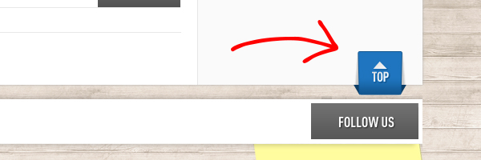
WHERE YOU SEE IT

Slide 5
HTML
ID: you will add an ID to a HTML tag that you want to send your client
Retrieval LINK: You will link the user to the ID that you have named for the particular section you want to take the client to.
Example:
<h1 id=“top”>WORKOUTS</h1>
<a href=“#top”>Back to top</a>

Slide 6
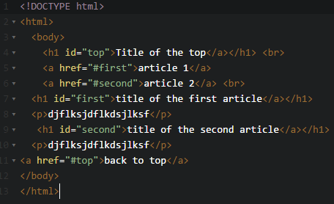
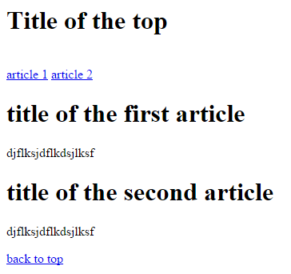

Slide 7
IF YOU CANT REMEMBER
TAGS: ID’s
LINKS: HASHTAG+ID

Slide 8
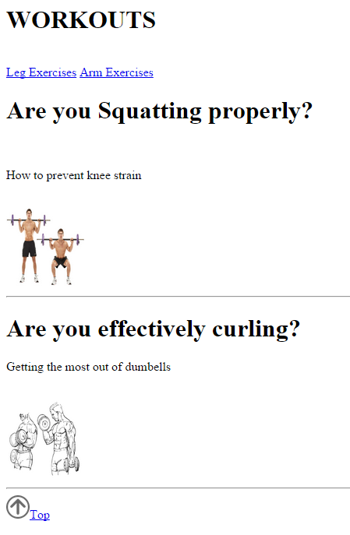
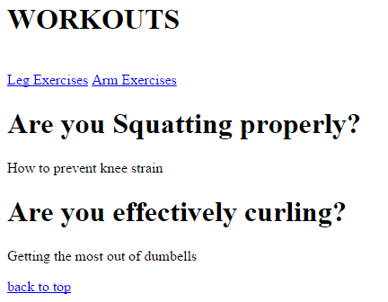
ACTIVITY

